Slide 1

Lending Club Case Study
By Mickell Als

Slide 2
Problem Statement
A lending club is a peer to peer lending facility. Borrowers reach out directly to individuals lending money.
With any loan there is risk of default. This analysis seeks to highlight the biggest factors affecting loan repayment

Slide 3
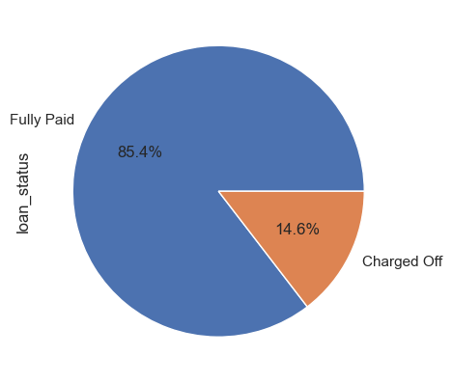
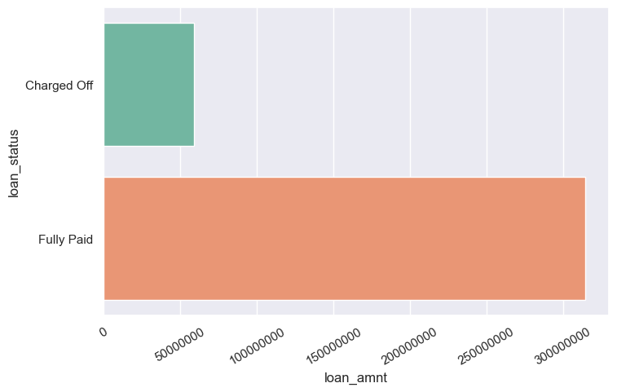
How Pervasive is Default
Nearly 15% of loans through the lending club are charged off (defaulted). This resulted in a total value loss of almost $60 million.

Slide 4
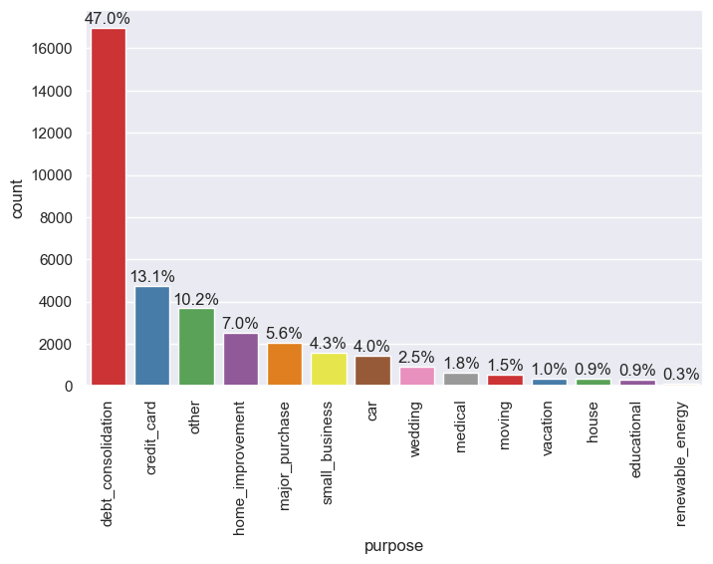
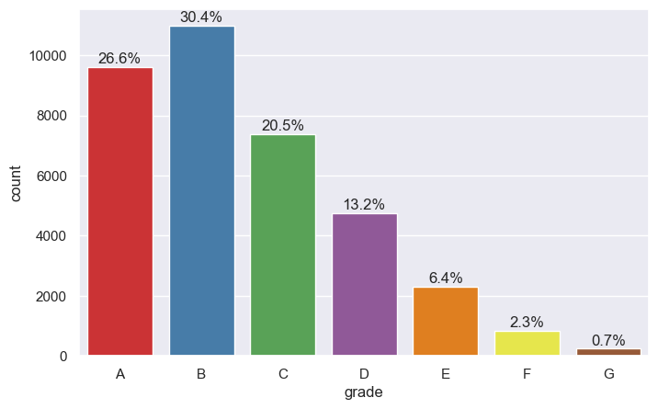
The Loan Characteristics
More than 80% of loans are issued in just 5 categories with debt consolidation accounting for 47% of all provided reasons
Higher grade loans are more commonly issued to applicants with Grades A and B accounting for 57% of loans

Slide 5
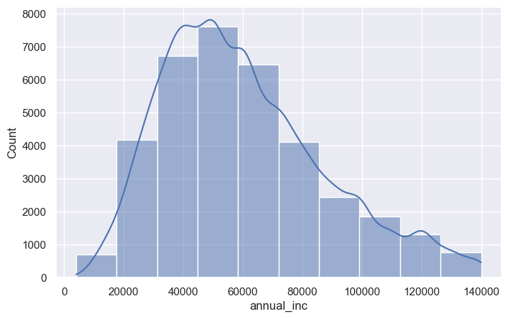
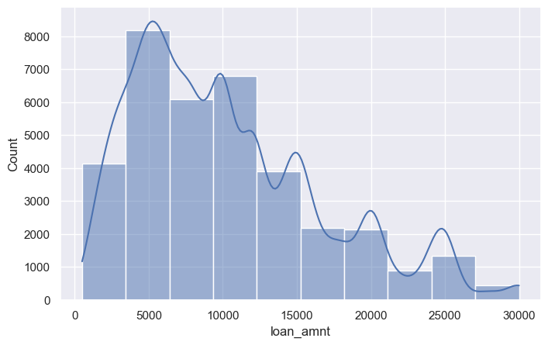
Characteristics Continued
Most applicants have incomes lower than the dataset average of $60K.
Loans $5K and 10K are most frequently requested
Significant loan values occur ever $5000

Slide 6
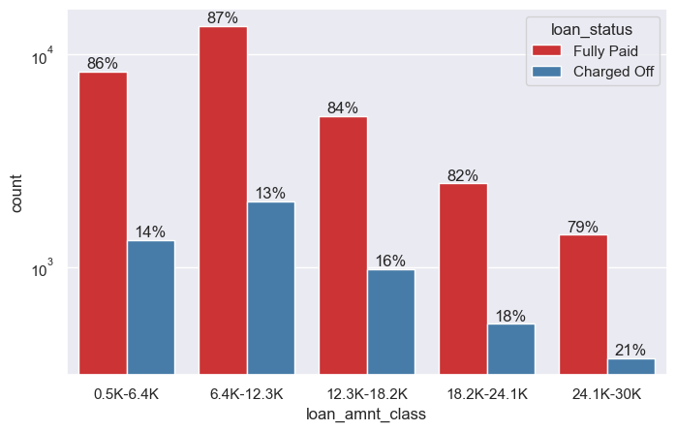
Default Risk Factors
While higher loan amounts are less common, borrowers who requested >$12.3K defaulted more frequently.

Slide 7
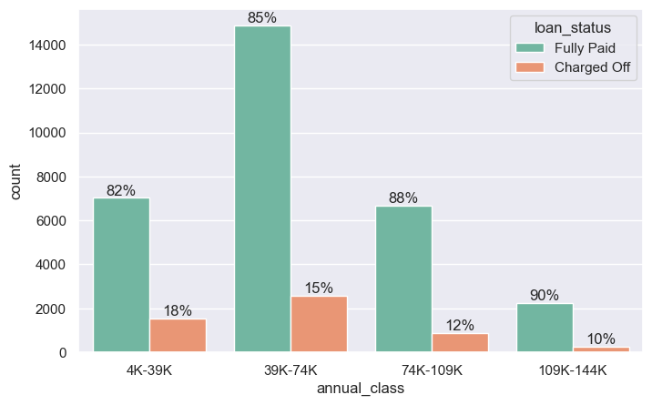
Default Risk Factors
As one would expect, loans issued to persons with a lower annual income tend to default more frequently.
persons making less than $39K defaulted 18% of the time
Persons making >$109K defaulted 10% of the time

Slide 8
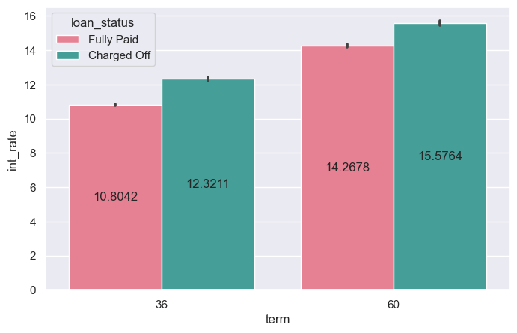
Default Risk Factors
When loan term and interest rate is considered.
36 Month term loans with interest >11% default more frequently
60 Month term loans with interest >14% as well

Slide 9
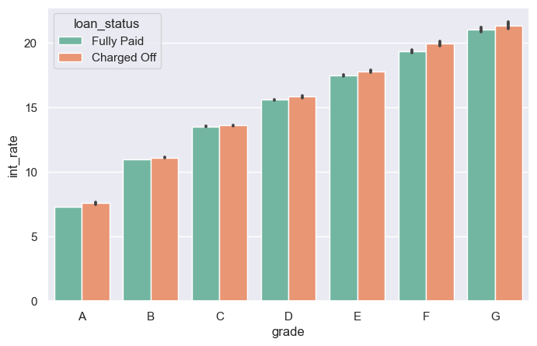
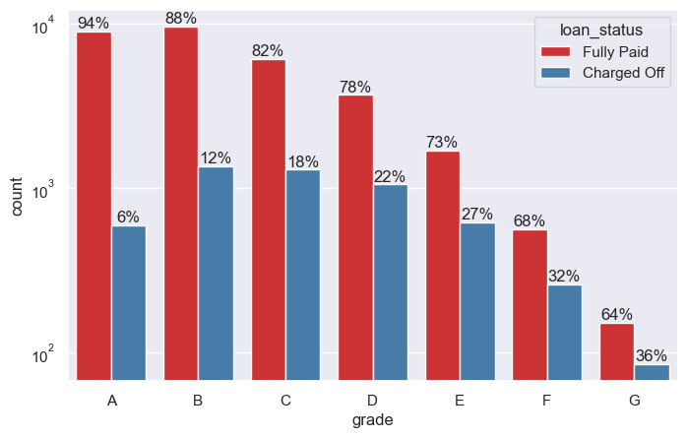
Default Risk Factors
Default risk increases as the loan grade decrease.
Lower grade loans also tend to have higher interest rates.
Lower graded applicants are those with an already raised default risk and higher interest rates may further this risk.

Slide 10
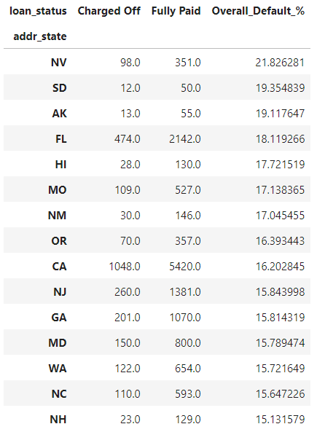
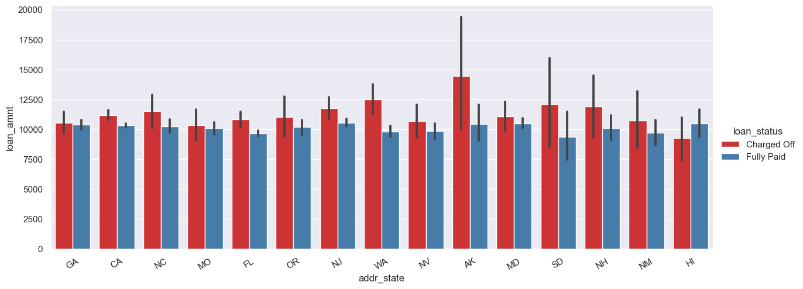
Default Risk Factors
Applicants from Nevada defaulted nearly 22% of the time.
High default locations also tend to request amounts above the median of $9K

Slide 11
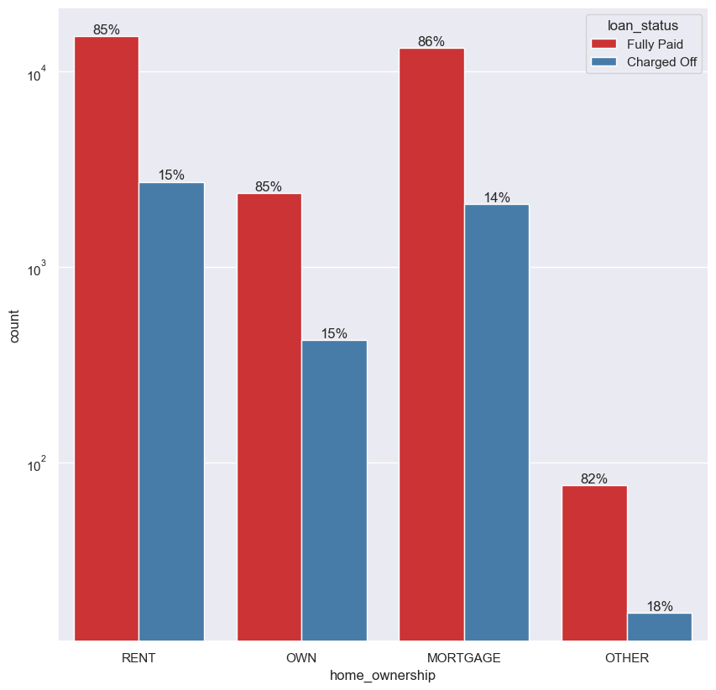
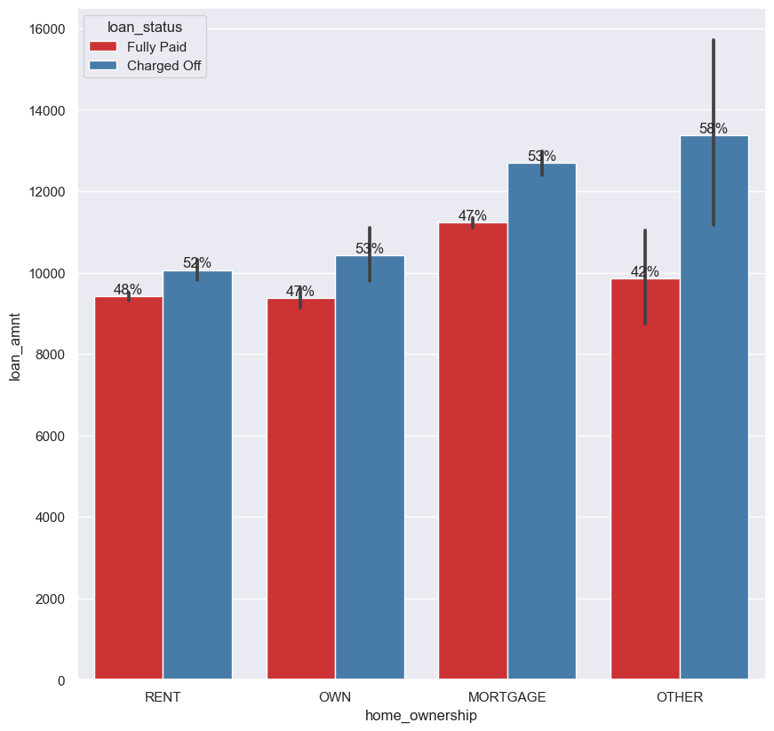
Default Risk Factors
Persons classed as Other for home ownership default more frequently and also request higher loan amounts.
Homeowners with a mortgages also take out larger loan amounts than all other groups but default less often.

Slide 12
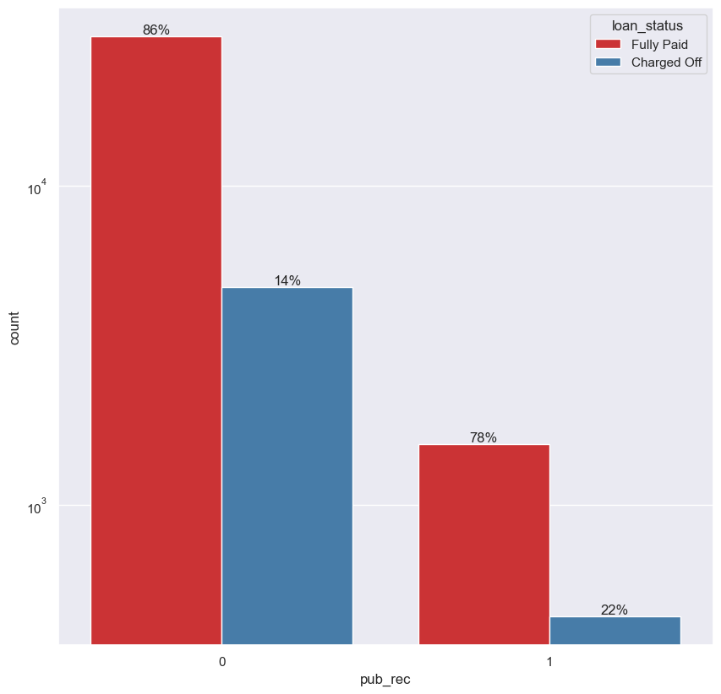
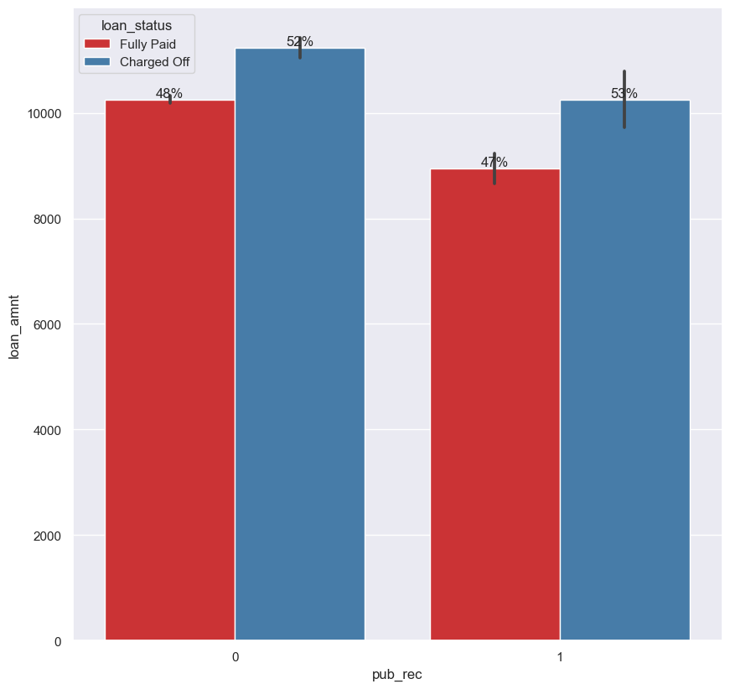
Default Risk Factors
Those with at least 1 derogatory note in their public record defaulted 22% of the time versus 14% for those with none.
Even though these borrowers tend to request lower amounts they still defaulted more often.

Slide 13
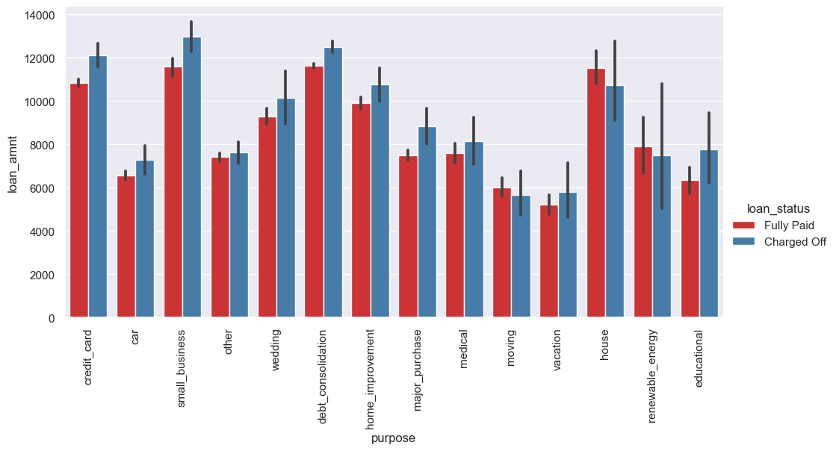
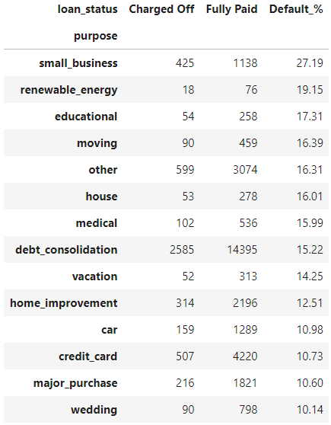
Default Risk Factors
Small Business loans account for 27% of defaults even though they account for less than 5% of all loans.
Of the top 5 most common reasons for taking a loan, only “other” default more than 15% of the time.
Debt consolidation, credit card, major purchase and home improvement loans are safer than small business, renewable energy, educational and moving loans

Slide 14
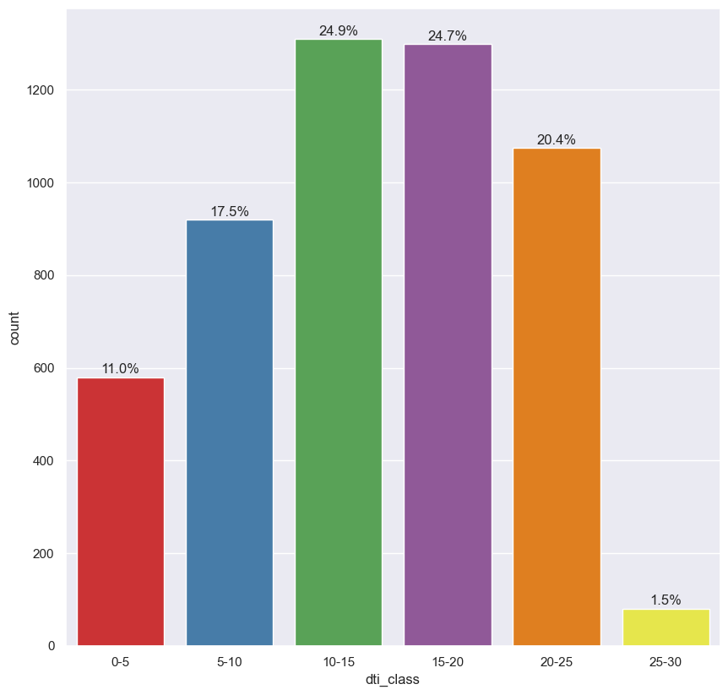
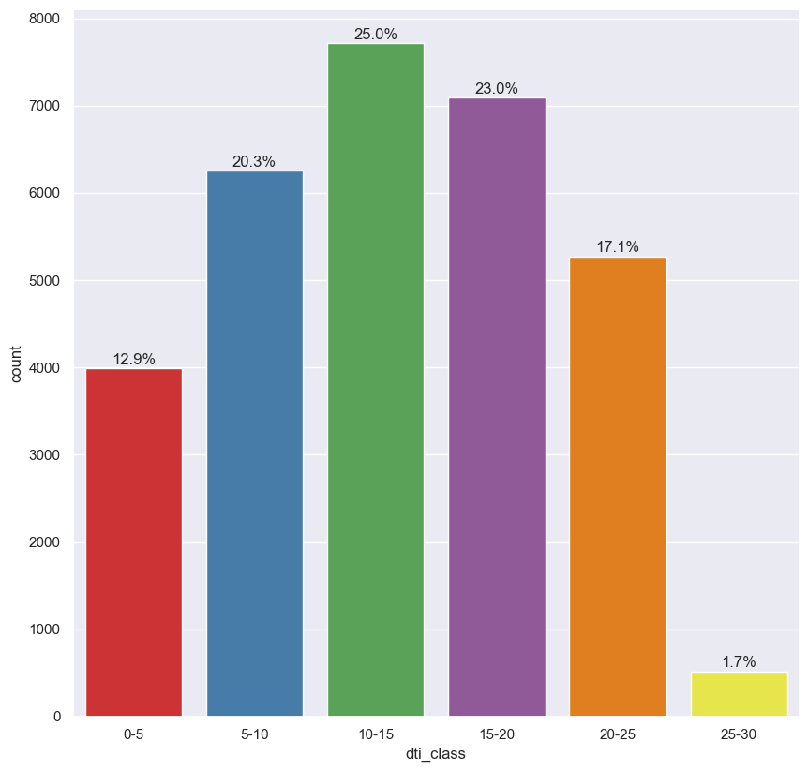
Default Risk Factors
Defaulters tend to have a Debt to Income ratio of 10-25%
Non-Defaulters tend to have a Debt to Income Ratio of 5-20%
Lower Debt to Income ratios are more likely to repay loans

Slide 15
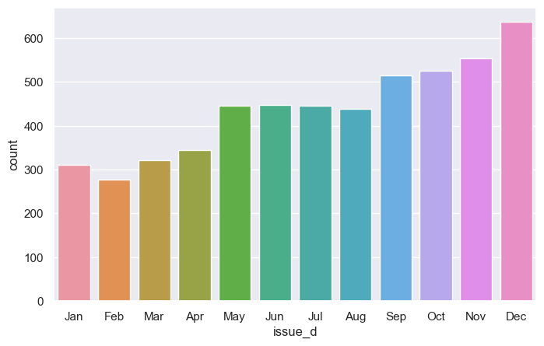
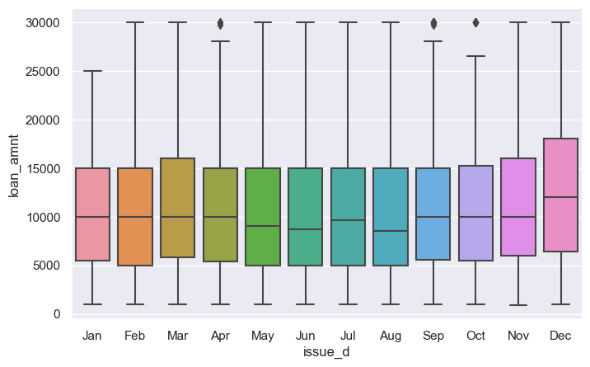
Default Risk Factors
Loans issued in December carry a higher mean value and default more frequently than loans issued in any other month.
Holiday loans are risky

Slide 16
Conclusions
Default risk is lowered for applicants with:
Loan amounts below $12.3K
Income above 74K annually
Interest rates below 11% and 14% for 36 and 60 term loans respectively
Address outside of Nevada
They own home, rent or pay mortgage
Have no derogatory notes on their public record
A loan issued outside of December
A loan not issued for small business, renewable energy, moving, education or other

